Slide 1

Short-Term rentals
City of Bentonville
April 28, 2023

Slide 2
The latest
Continue to receive complaints and questions about short-term rentals.
STR ordinance came out as the #2 priority by the City Council and Planning Commission.
Senate Bill 197 – restricting cities from regulating STRs – Failed in the House.

Slide 3
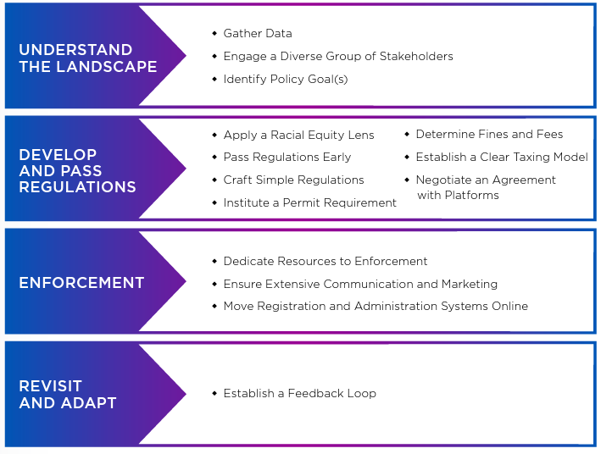
National League of Cities STR Policy Guide

Slide 4
What are STRs?
Short-term rentals are a form of Homestay
Includes Bed & Breakfasts, Vacation Rentals, etc.
Differ from long-term rental or by-right leasing as it operates on a different time and/or unit scale as well as social impact.
Largely went unregulated at state/local levels for many years leading to quick proliferation.

Slide 5
What are STRs?
Three common listing types:
Whole home/property
Accessory dwelling
Individual room(s)

Slide 6
Current Regulations
In Bentonville, no regulations are applied to short-term rental uses. Zoning regulations pertaining to structures and site design are enforced when triggered through permitting.
Informal fire safety guidance provided when asked.
State of Arkansas requires state tourism and sales tax be paid.
Some HOAs may restrict or not allow STRs through covenants.

Slide 7
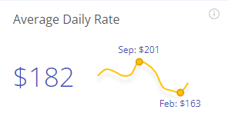
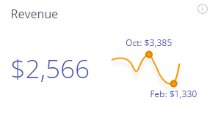
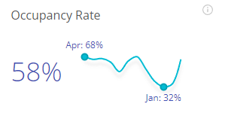
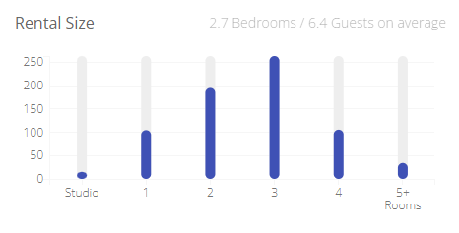
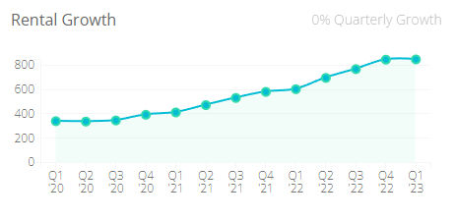
The landscape*
749 active listings
*in 72712
Data from AirDNA, Apr. 2023

Slide 8
How we compare
 | Bentonville* | Rogers* | Fayetteville* | Springdale* | Bella Vista*
Tot. Listings | 749 | 395 | 775 | 140 | 544
Avg. $$ Rate | $182 | $218 | $198 | $175 | $166
Mo. Revenue | $2566 | $2686 | $2318 | $2200 | $2276
Occ. Rate | 58% | 53% | 50% | 57% | 55%
Size (Bd/Gst) | 2.7/6.4 | 2.8/7.7 | 2.5/5.9 | 2.6/6.5 | 2.7/7.1
1st Qtr Growth | 0% | 0% | -6% | -1% | 2%
*in approximate Zip Codes
Data from AirDNA – Apr. 2023

Slide 9
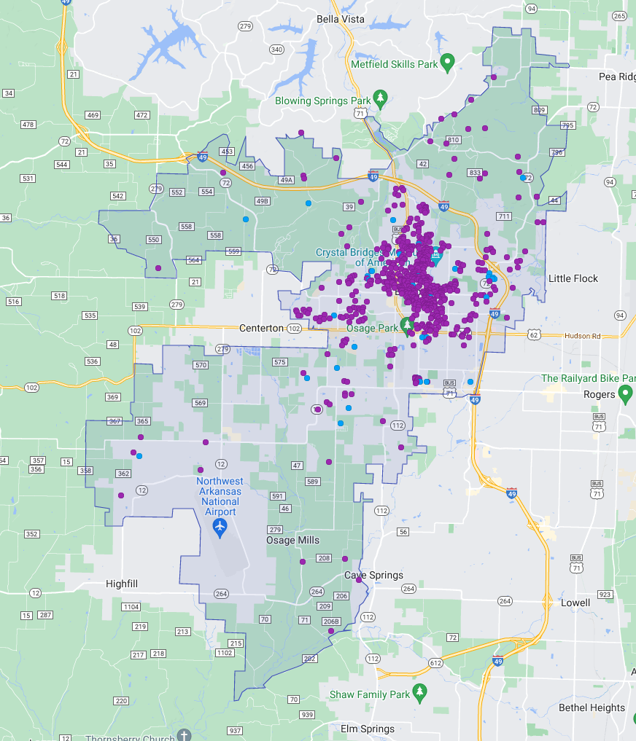
Data from AirDNA – end of Jan. ‘23

Slide 10
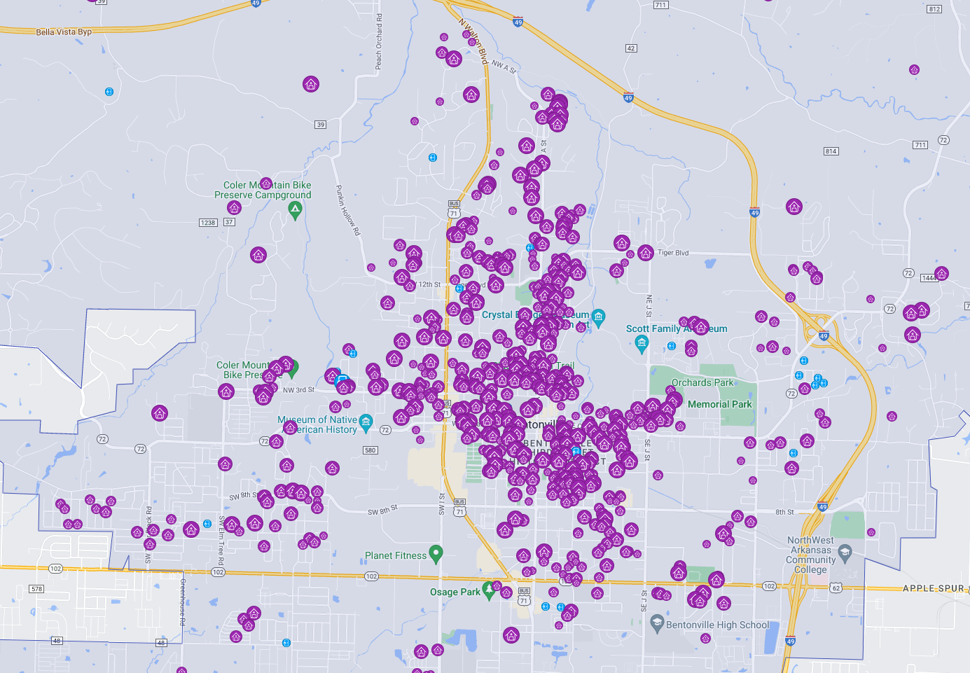
Data from AirDNA – end of Jan. ‘23

Slide 11
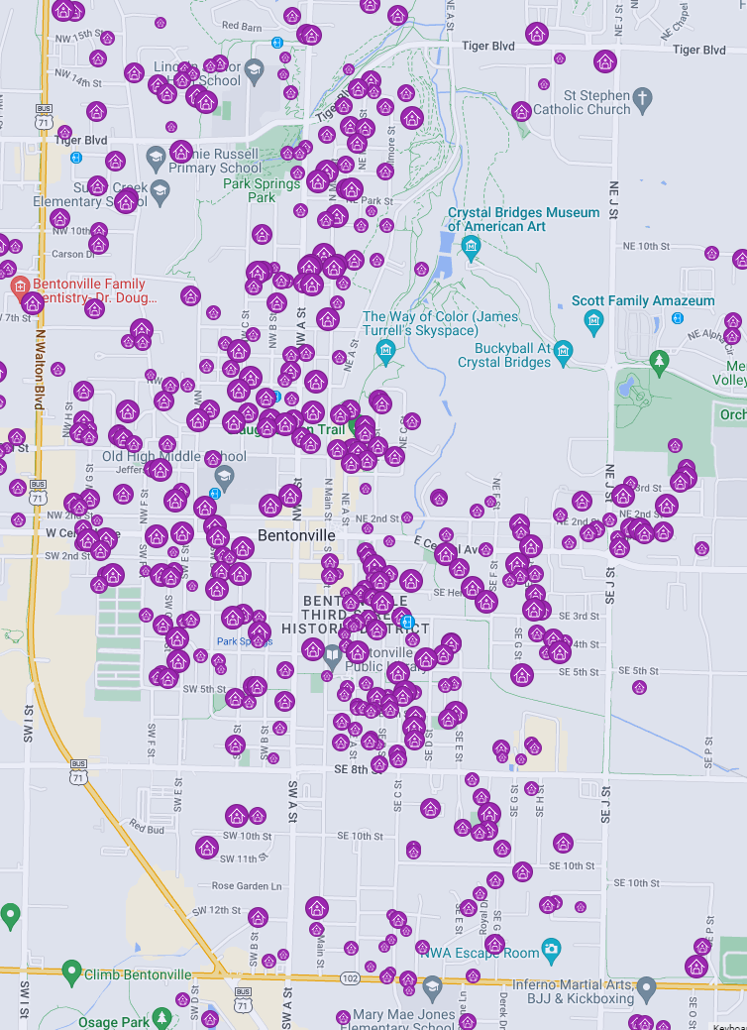
Data from AirDNA – end of Jan. ‘23

Slide 12
Positive Impacts
Provide unique opportunity to experience Bentonville.
Provides residents an opportunity to earn additional income, thereby increasing community wealth.
May allow some residents to stay in their homes by providing additional income.
Notes:
Long-time residents create community; transient populations come for a brief experience.
What makes Bentonville one of America’s “Best Small Towns” is not the number of STRs – it’s the people who live, work, and play here.

Slide 13
Positive Impacts
Very likely to be well-maintained. Market-driven response leads to cleanliness and positive upkeep.
When the market changes, often converted to long-term rentals or sold.
Notes:
Long-time residents create community; transient populations come for a brief experience.
What makes Bentonville one of America’s “Best Small Towns” is not the number of STRs – it’s the people who live, work, and play here.

Slide 14
Negative Impacts
Encouraging tourism at the expense of neighborhoods
Long-time residents create ties to the community, vibrancy, and social connections; transient populations come for a brief experience. What makes Bentonville one of America’s “Best Small Towns” is not the number of STRs or visitors – it’s the people who live, work, and play here everyday.
STRs displace city residents and eat up an extremely limited supply of housing.

Slide 15
Negative Impacts
3.1% (704 listings) of housing stock (22,436 units*) is actively listed – up from 1.2% (290 listings) in January 2021.
704 STRs = housing for over 1,850 residents based on 2.64 avg. household size*.
43% vacancy rate is the equivalent of 302 housing units sitting unused every month, or housing for 800 residents.
*US Census
Notes:
Average home price in Bentonville in Sept. 2022 was $384k. $2679 monthly income equivalent to $425k house.
This is especially pertinent in the face of the affordable housing crisis.
When people cannot live in town close to their places of employment – increases transportation costs and time, as well as traffic and congestion and long-term costs to the city on maintenance.
This isn’t to say we should have no STRs, but it is important to understand their impact, esp. in large number, on the make up of our city.

Slide 16
Negative Impacts
Average monthly revenue of Bentonville STRs exceeds the average monthly housing costs of Bentonville homeowners.
Median monthly housing costs are $1,800 (incl. mortgage, taxes, & insurance.)** compared to the $2,600 monthly revenue.
Average home price in Bentonville in Sept. 2022 was $384,000*. The $2,599 monthly income for an STR is equivalent to mortgage on $425,000 house.
*Arvest Skyline Report **Median from 2017-2021 ACS
Notes:
STR investors can outcompete homebuyers. This in turn drives up home prices if there is bidding that inflates the final sale price. The loss of the home to a resident lowers supply which raises prices. Any increase in sale/purchase price of a home or land increases prices for renters as well.

Slide 17
Negative Impacts
People opt to live further from employment in order to find a place to live – increasing transportation costs to resident and the city.
Traffic and congestion increase, in turn affecting maintenance and capital costs to the City.
Notes:
Long-time residents create community; transient populations come for a brief experience.
What makes Bentonville one of America’s “Best Small Towns” is not the number of STRs – it’s the people who live, work, and play here.
280 STRs sit vacant every month that no one can use as a residence.
Average home price in Bentonville in Sept. 2022 was $384k. $2679 monthly income equivalent to $425k house.
This is especially pertinent in the face of the affordable housing crisis.
When people cannot live in town close to their places of employment – increases transportation costs and time, as well as traffic and congestion and long-term costs to the city on maintenance.
This isn’t to say we should have no STRs, but it is important to understand their impact, esp. in large number, on the make up of our city.

Slide 18
What are the Goals we Aim to Achieve?

Slide 19
Potential Goals (Based on NLC Report)
Prevent the Loss of Rental Housing
Slow or Prevent the Overgrowth of STRs
Combat Displacement
Preserve the Residential Quality of Neighborhoods
Ensure the Health and Safety of Guests and Residents
Capturing Tax Revenue
Support Tourism in a Balanced Way
Allow for Economic Gain for Residents

Slide 20
Avenues for regulation on Number/location of STRs
No regulation(s)
Ban
Density-based
  Buffer
Typology-based
  Differentiate between whole unit, ADU, bedroom, etc.
Quota
  City- or district-wide cap
  Conditional Use Permit
  Protest model
  Combination
Notes:
Given the type of use involved, it is difficult to divorce the interplay between zoning and the building and fire codes. The ordinance is most capable when all facets are included at the ground level.

Slide 21
Avenues for regulation on Operation of STRs
No regulation(s)
License/Permit
Inspection
  Posting
  Conditional Use Permit
    Conditions set on case-by-case basis
  Combination
Notes:
Given the type of use involved, it is difficult to divorce the interplay between zoning and the building and fire codes. The ordinance is most capable when all facets are included at the ground level.

Slide 22
Some paths forward
Recognize the disparate impact on the downtown area compared to the rest of the city.
Two-part system that holds different regulations for downtown vs. rest of the city.
Potentially:
Quota/Protest
Typology-based quota/Buffer
Notes:
Don’t forget about grandfathering.

